Slide 1
2026 Legislative / Regulatory / Political Update
Michael T. Oscar
Director of Legislative Affairs
FCA International

Slide 2
Government Relations is an FCA Member Benefit
For Your Legislative Questions,
contact us:
Mike Oscar
moscar@finishingcontractors.org
FCA Director of Legislative Affairs

Slide 3
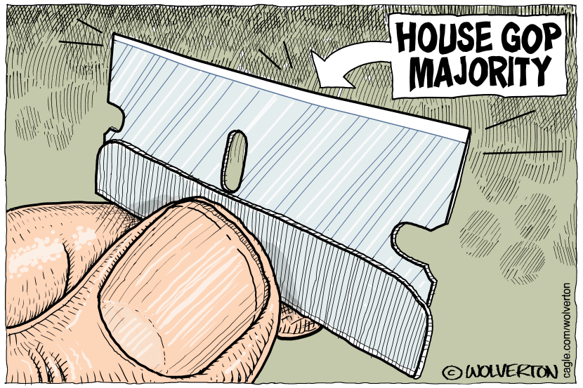
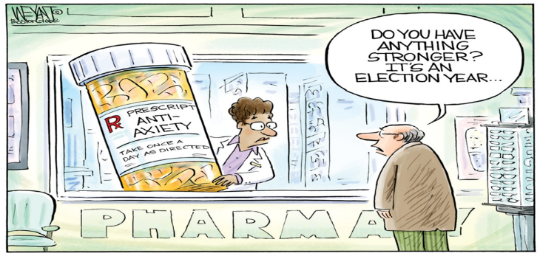
119th Congress - House 218R – 213D / Senate 53R – 47D
HOUSE: 31 Republicans and 21 Democrats have announced that they will not be seeking re-election.
SENATE: Nine incumbent Senators, comprising five Republicans and four Democrats, are also not seeking re-election.
This marks the highest number of members of Congress not seeking re-election since 2011!

Slide 4
2026 Legislative and Regulatory Priorities

Slide 5
Legislative Priorities
2026 Legislative Priorities*
Apprenticeship Funding | Prompt Payment
Nation’s Infrastructure Investment | Government Regulations on the Industry
Identify Grant Opportunities | Immigration Reform
Misclassification of Employees | Multiemployer Pension Reform
Bid Listing on Federal Construction Projects | Opposing Efforts to Modify, Suspend, or Repeal Davis Bacon Act
Public Private Partnerships | Trade Deals
*No particular order

Slide 6
Legislative Priorities
Multiemployer Pension Reform
  Authorize the creation of the innovative composite plan design, which would combine the key features of defined benefit and defined contribution plans
Workforce Development
  Streamline and modernize the National Apprenticeship Act
  Prevent the Misclassification of employees as independent contractors
  Oppose Efforts to Repeal, Suspend, or Modify the Davis-Bacon Act
  Oppose any efforts to revive Industry-Recognized Apprenticeship Programs (IRAPs)
  Oppose Limits on the Use of Project Labor Agreements
Contracting Reform
  Ensure payment protections for construction subcontractors and suppliers performing federal construction under Public-Private Partnerships
  Prohibit the utilization of reverse auctions for the procurement of construction contracts
  Improve the design-build construction process
  Ensure responsible contractors are given priority in the bidding process of federal contracts

Slide 7
Legislative Priorities
Federal Tax Reform – One Big Beautiful Bill Act (OBBBA) – 7/4/25
  Make the Pass-Through Deduction Permanent to Ensure Certainty and Predictability
  Repeal the Estate Tax
  Repeal the Alternative Minimum Tax
Tariffs
  Advocate for Fair Tariff Policies that protect small businesses from Unfair Competition
  Simplify and Expand access to exclusion requests for tariffs, such as those on goods from China
  Promote Export Opportunities
Immigration Reform
  Support expanding the H-2B visa program
  Increase employment-based visa quotas
  Create a market-driven visa program for foreign workers
  Support protections for Deferred Action for Childhood Arrivals (DACA) and Temporary Protected Status (TPS) recipients in the construction industry
  Improved E-Verify system with safeguards for employers

Slide 8
2025 Legislative and Regulatory Accomplishments

Slide 9
2025 Legislative and Regulatory Accomplishments
Change Order Reform - "Small Business Payment for Performance Act of 2025" (H.R.4615)
Public Private Partnerships (P3s) – “Water Infrastructure Subcontractor &Taxpayer Protection Act” (H.R.1285/S.570)
Joint FCA International and IUPAT Legislative Effort- “Bridge Corrosion Prevention and Repair Act” (H.R.4170)
NY Scaffold Law - “Infrastructure Expansion Act of 2025” (H.R.3548)
College Apprenticeships – “Support the College Apprenticeship Act” (H.R.4588/S.2028)
FY27 NDAA (Defense Bill) - Procurement Reform
House Construction Procurement Caucus
Comments: On the Department of Labor’s Final Rules on overtime, independent contractor status, Project Labor Agreements (PLAs), Davis Bacon, and more...
Delay the Corporate Transparency Act

Slide 10
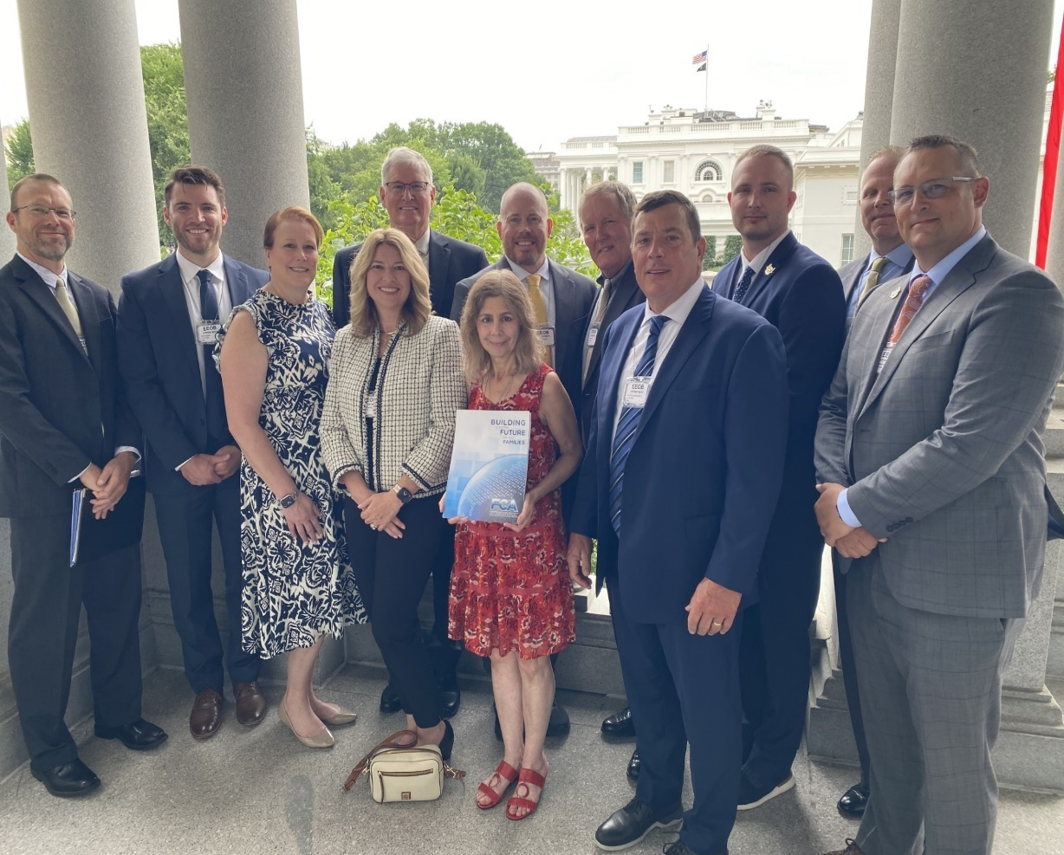
2025 FCA Legislative Fly-In
FCA International Members Outside the West Wing of the White House

Slide 11
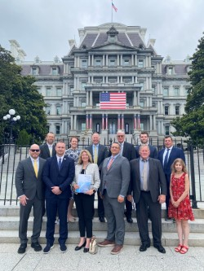
2025 FCA Legislative Fly-In
FCA International Members Outside the Eisenhower Executive Office Building

Slide 12
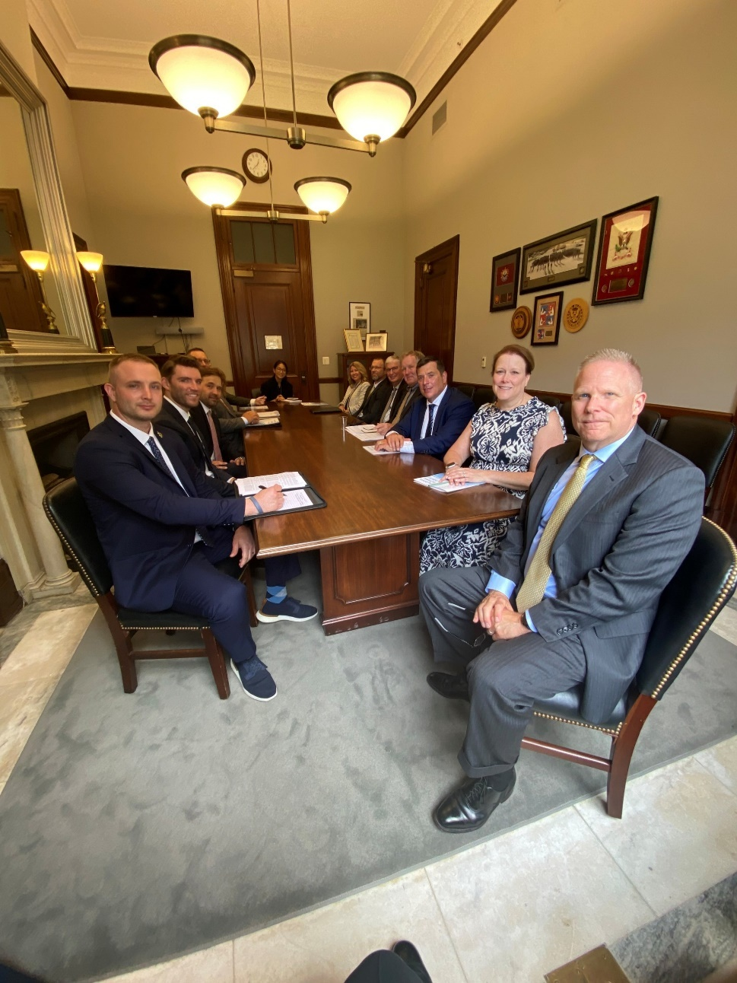
2025 FCA Legislative Fly-In
FCA International Members Meet with Sen. Ernst (R-IA)’s Senate Small Business Committee Legal Counsel to discuss change order reform

Slide 13

Top Takeaways – THANK YOU!
Educate, Advocate, and Legislate
Procurement Reform – FAR 2.0
Labor Shortages – Worker Misclassification / Workforce Development / Apprenticeship Programs
Supply Chain Issues – Trade Agreements
Regulatory Reform – Tax Policies
2026 Fly-In!!!

