Slide 1

Wages, Workers, and Conundrums
Signatory Contractors Conference
March 3, 2026
Scottsdale, AZ
Construction Labor Research Council
Carey Peters, Ph.D.

Slide 2
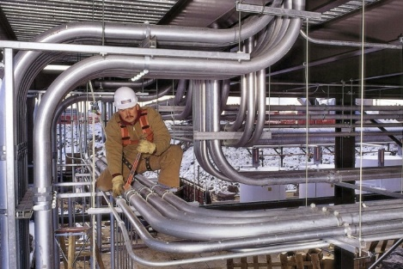

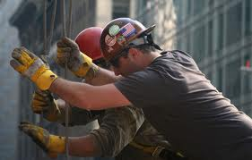
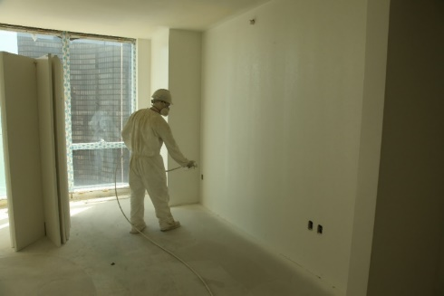


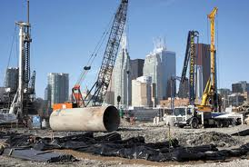


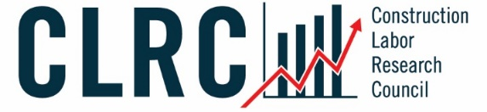
CLRC
We Support the
Union Construction
Industry!
Wage and Fringe Benefits
Market Share
Union-Nonunion Wage and
Fringe Benefits Comparison
Contract Cost Analysis
Benchmarking
Workforce/Labor Analysis
Safety Surveys
Custom Research

Slide 3
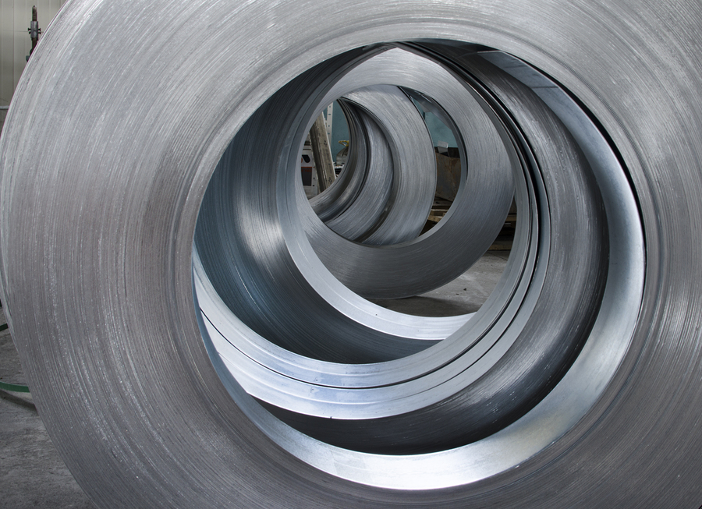

CLRC
CLRC Sponsoring Associations
Associated General Contractors of America (AGC)
Associated Roofing Contractors of the Bay Area Counties (ARCBAC)
Central States Insulation Association (CSIA)
FCA International (FCA)
International Council of Employers of Bricklayers and Allied Craftworkers (ICE)
Mechanical Contractors Association of America (MCAA)
National Architectural Glass & Metal Association (NAGMA)
National Electrical Contractors Association (NECA)
National Fire Sprinkler Association (NFSA)
North American Contractors Association (NACA)
Sheet Metal and Air Conditioning Contractors’ National Association (SMACNA)
Signatory Wall and Ceiling Contractors Alliance (SWACCA)
The Association of Union Constructors (TAUC)

Slide 4
CLRC
FCA
International !

Slide 5
Agenda
1
2
3
Key Business Knowledge
A broad overview of useful information for association execs, union officials, and contractors in the
construction industry
The
Conundrum
Competing interests provide the opportunity for renewed listening, deeper understanding, and joint problem solving
Dollars and “Sense”
Making “sense” of the dollars and cents in settlements in the union sector of the construction industry

Slide 6
Key Business Knowledge
A broad overview of useful information for association execs, union officials, and contractors in the construction
industry
1

Slide 7
Key Business Knowledge: Topics
CPI
Cost of Living
Total
Compensation
U.S.
Population
Construction
Spending
Employment in
Construction
Work
Projections

Slide 8
CPI: United States
Beware!
Source: BLS

Slide 9
CPI: US and Major Regions
Really not much difference between the major regions and the US
Source: BLS

Slide 10

CPI: Key Takeaways
Inflation for the U.S. peaked at about 8.0% and has subsided to around 3.0%
Inflation has been remarkably similar across four broad geographic regions

Slide 11
Total Compensation Trend: Union - Nonunion
Source: BLS
NOTE: Union reflects ALL represented workers in all industries (not just construction)

Slide 12
Total Compensation Trend: Union - Nonunion
Source: BLS, CLRC
Union workers in construction earn more than the typical union worker according to CLRC data

Slide 13
Total Compensation: Pay Growth
2005-2024
Source: BLS, CLRC
Union TC grew more than nonunion monetarily

Slide 14
Total Compensation: Various Occupations
Source: BLS
This slide reflects ALL workers (union + nonunion)

Slide 15
Total Compensation: Various Occupations
Source: BLS, CLRC

Slide 16
Total Compensation: Union-Nonunion Wage & Fringe Comparison
Source: CLRC

Slide 17

Total Compensation: Key Takeaways
Union workers are paid more than nonunion
The gap is especially noticeable in fringe benefits
Union total compensation has grown more than nonunion monetarily
Union craft workers are paid about the same as teachers and registered nurses

Slide 18
U.S. Population
Population growth was just 0.5% in 2025!
Source: Census Bureau

Slide 19
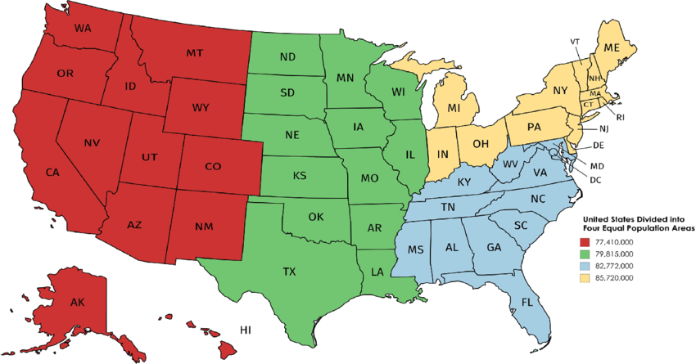
U.S. Population: Growth by Region
Source: Census Bureau

Slide 20

U.S. Population: Key Takeaways
Population growth is slowing
The West and South regions have been the fastest growing regions for decades

Slide 21
Construction Spending
Source: Census Bureau

Slide 22
Construction Spending
Source: Census Bureau

Slide 23
Construction Spending by Region
Big difference!
Source: Census Bureau

Slide 24
Construction Spending by Type
Source: Census Bureau

Slide 25

Construction Spending: Key Takeaways
In 2024 commercial spending was down and data center, education, religious, and manufacturing construction was up
Although growing significantly, $31 billion in data center construction is still a small part of the overall spend

Slide 26

A respite from all that data…
Camelback mountain…just 10 miles south of us!

Slide 27
Employment: Craft Proportions
Proportion of craft workers in construction in each craft (union + nonunion combined)
Source: BLS

Slide 28
Employment: Select Industries
Source: BLS

Slide 29

Employment: Union Market Share
Industry
Source: BLS

Slide 30
Employment: Union Market Share
Occupation
Source: BLS

Slide 31

Employment: Key Takeaways
Construction, the MOST IMPORTANT industry of ALL ☺, has about 8.1m employees. This includes craft workers plus the less important like lawyers and accountants (but not CLRC employees!).
Union market share in construction has two answers:
Industry: 10.3%
Occupation: 15.4%
Union market share in construction has declined (yes there are two answers):
Industry: -13.3%
Occupation: -16.8%

Slide 32
The Conundrum
Competing interests provide the opportunity for renewed listening, deeper understanding, and joint problem solving
2

Slide 33
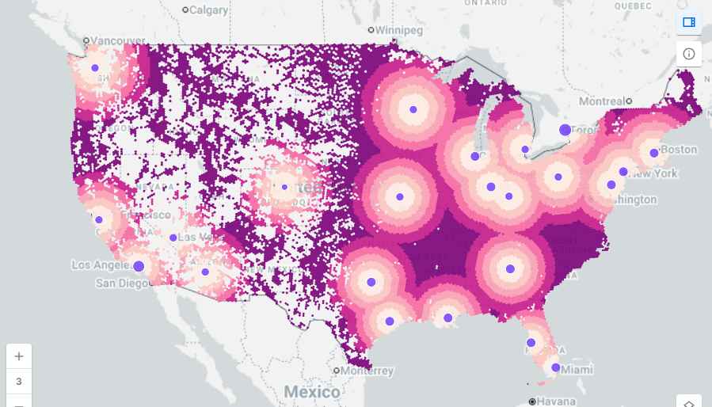
A Real-World Conundrum
Distance from a Taylor Swift Concert
One person wants to get as close as possible to a Taylor Swift concert.
Another person wants to get as far away as possible from a Taylor Swift concert!
These two people live together!

Slide 34
The Conundrum
The cost of living went up a lot for employees
The cost of materials went up a lot for contractors
These two groups of people work together!

Slide 35
The Conundrum
The legacy of price surges from 2021-2023 will not go away…

Slide 36

The Conundrum
High inflation put pressure on contractors to pay employees more
Yet even higher materials costs made it harder for contractors to pay employees more
Contractors and employees are caught in a conundrum

Slide 37
Projections: Architectural Billings Index
Regression to the mean
…a little bleak for 2026
COVID
2005
Recession
2025
Chart shows if architectural billings are above or below average
Source: AIA

Slide 38
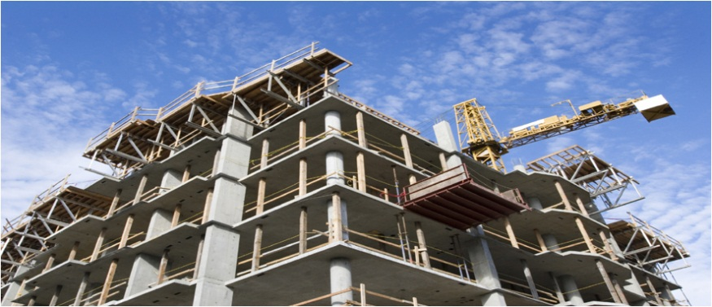

Projections: Key Takeaways
The ABI (Architectural Billings Index) is known as a 9 to 12 month leading indicator of construction activity
The ABI was below average in 2025, suggesting reduced construction spending in 2026

Slide 39
Dollars and “Sense”
Making “sense” of the dollars and cents in the union sector of the construction industry
3

Slide 40

Increase Trends – First Year

Slide 41
Increase Trends – First Year

Slide 42
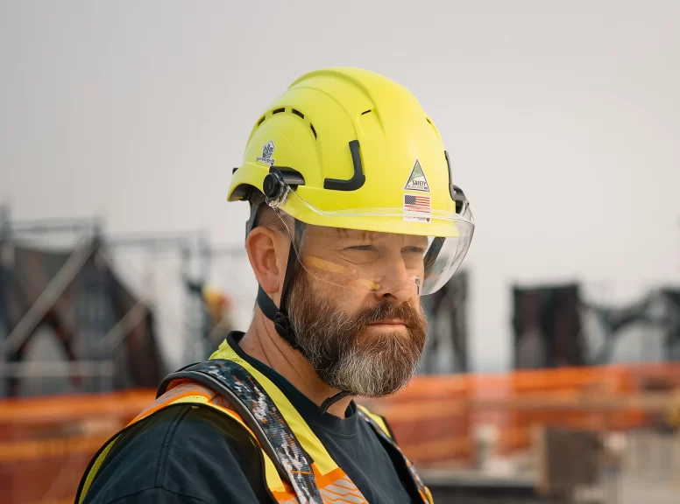

So What Caused the Change?
Worker Shortage?
COVID 19?
Inflation!

Slide 43
First Year Increases by Region

Slide 44
First Year Increases by Region

Slide 45
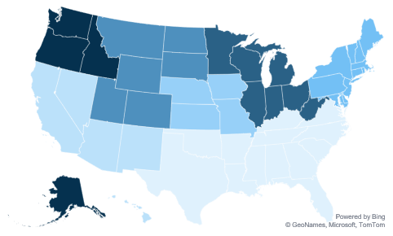
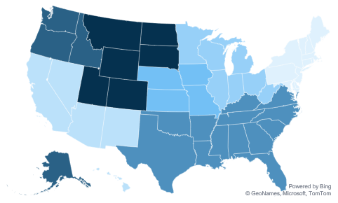
First Year Increases by Region
5.4%
5.0%
4.3%
5.0%
5.1%
4.5%
5.1%
$3.29
$2.68
$3.15
$3.11
$3.11
$4.53
$2.34

Slide 46
Average Total Package Rate by Region
$28.17
56%

Slide 47
Allocation of Total Package by Craft

Slide 48
Total Package Increase Trend
5
2
1
3
4

Slide 49
Total Package Increase Trend

Slide 50
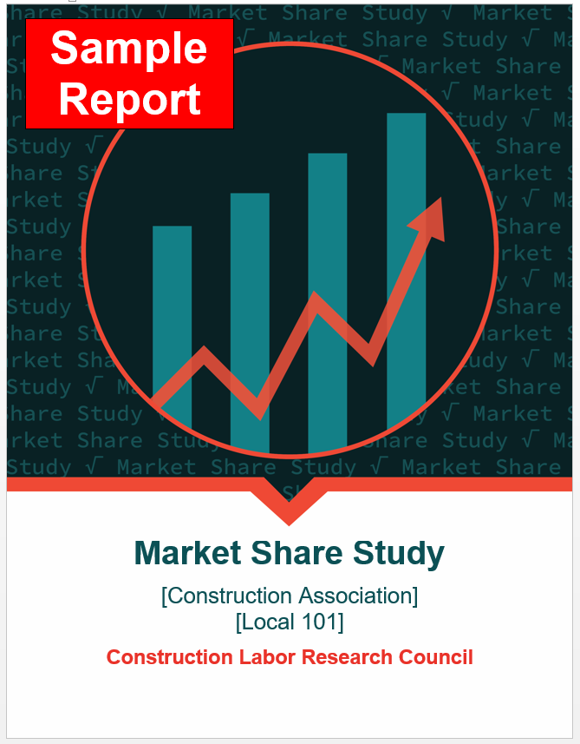
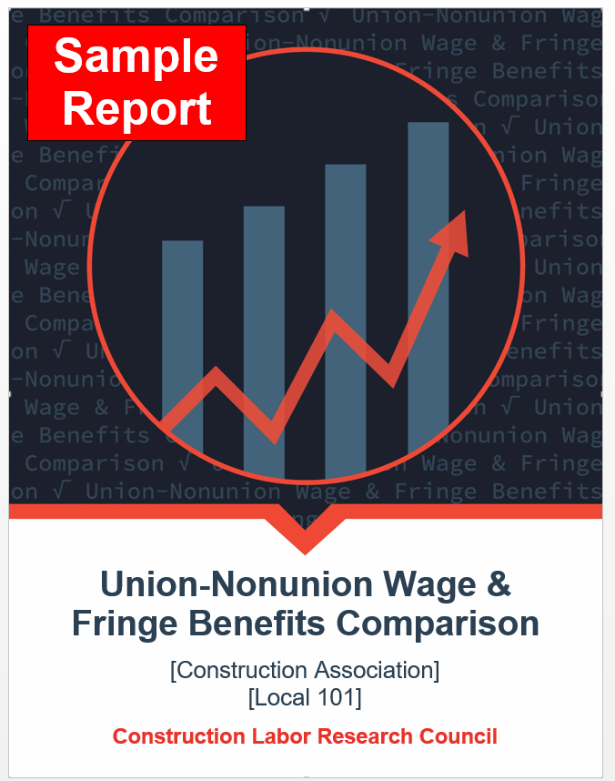
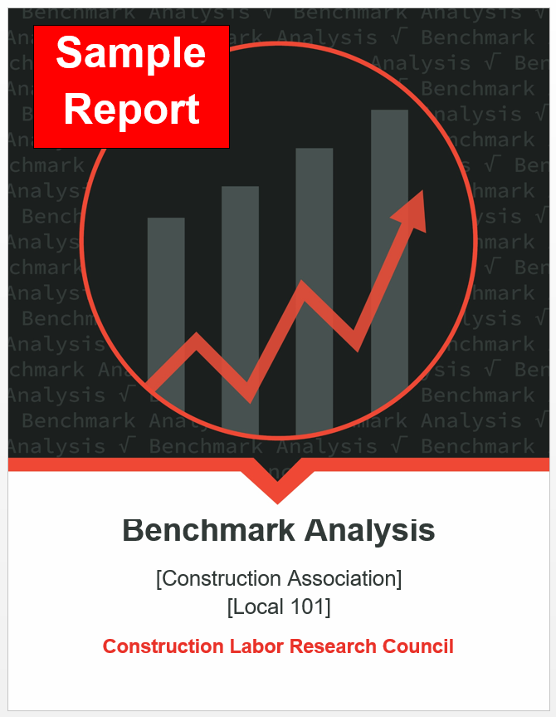
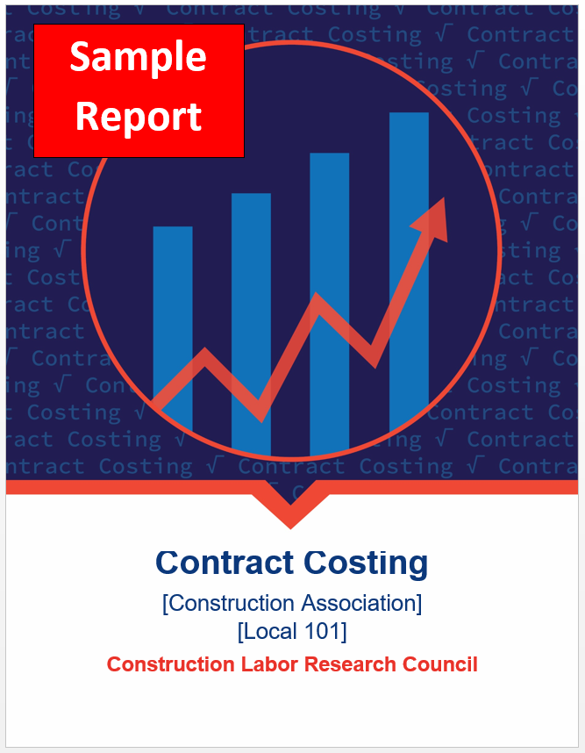
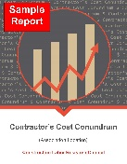
CLRC Products
with Sectors
Market Share
Union-Nonunion Wage & Fringe Comparison
Benchmark Analysis
Contract Costing
Contractor’s Cost Conundrum
with Trends

Slide 51
Construction Labor Research Council
Carey Peters, Ph.D.
Executive Director
202-347-8440
www.clrcconsulting.org
clpeters@clrcconsulting.org

